Slide 1
The Journey From Isolation to Community
Angela Matthews | Miguel Sanchez | Donna Armes-Thomas
July 7, 2022

Slide 2
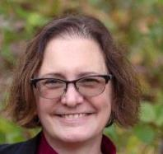
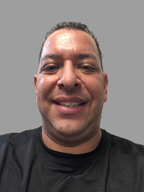
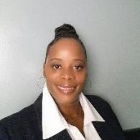
Authors
Angela Matthews is a Course Operations Specialist for the Center of Academic Innovation at the University of Michigan. She also teaches writing, research, and transition skills to help entering freshmen adapt to college. Her doctoral dissertation in Higher Education focused on the connection between grief and doctoral attrition. Her other research interests include qualitative methods, the benefits of writing as therapy, and distance education.
Miguel Sanchez is currently a K-2 Phys. Ed. Teacher for Manassas Park City Schools. Previously, he worked in Higher Education for 12 years, teaching and working for an online institution. He holds a Bachelor’s Degree in Physical Education and a Master’s in Athletic Coaching Education from West Virginia University (WVU) in Morgantown, WV. Miguel has a passion for working in education at all levels to help students reach their goals.
Donna Armes-Thomas is a United States Marine Corps veteran and recently completed her doctoral program in Technology and Education at Eastern Michigan University. Her dissertation research investigated copyright in the public K-12 setting. Donna is a highly motivated and dedicated educator with 14 years of teaching experience in online, in-classroom, professional, and blended modalities for 10+ institutions.

Slide 3
Today’s Overview
Faculty who teach in an exclusively online environment often feel isolated, which may lead to decreased cognitive ability, depression, and increased mortality rates. In addition to personal detriments, these issues could negatively impact teaching performance.
In this presentation, we will discuss
Define what is a CoP
Examine how participating in a CoP can help ease the feeling of isolation during teaching exclusively in an online environment
Discuss the benefits of CoP participation
Share the successes of CoP & ongoing CoP
Participating in a Community of Practice (CoP) can lead to many opportunities and experiences.

Slide 4
Concept of Communities of Practice
The concept of Communities of Practice (CoP) was originally introduced to describe communities of people who are interested in discussing and developing a shared practice of any kind (Wenger, 1998).
Originating in studies of apprentices, CoPs proved to have immediate relevance to education, both in inducting students into existing or new CoPs, and in describing and encouraging teaching and research communities.

Slide 5
Community of Practice (CoP)
Definition:
A Community of Practice (CoP) is a group of people who share a concern or a passion for something they do and learn how to do it better as they interact regularly.
(Wenger, n.d.)

Slide 6
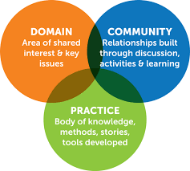
WHAT ARE THE KEY CHARACTERISTICS
Three key characteristics of Communities of Practice are:
  Domain: a common interest that connects and holds together the community;
  Community: a community is bound by the shared activities they pursue (for example, meetings, discussions) around their common domain;
  Practice: members of a community of practice are practitioners; what they do informs their participation in the community; and what they learn from the community affects what they do.

Slide 7





Benefits of Communities of Practice
According to Wenger (1998), communities of practice provide benefits that are important because they:
Educate by collecting and sharing information related to questions and issues of practice
Support by organizing interactions and collaboration among members
Cultivate by assisting groups to start and sustain their learning
Encourage by promoting the work of members through discussion and sharing
Integrate by encouraging members to use their new knowledge for real change in their own work

Slide 8

Benefits for Us Working in our CoP Groups
The ability to help innovate
The feeling of support rather than solitude
Trust

Slide 9
Helping others acclimate to an Online Environment
Experience of transitioning from exclusively Online Learning to Traditional Brick and Mortar Learning (K-2 Setting)
Experience of pivoting during the Covid-19 pandemic in a K-2 setting
Outcomes of the pivot during and currently due to Covid -19 pandemic

Slide 10
Main Takeaways
We encourage faculty to consider CoP groups, even if they feel hesitant
Experiment with less formal community

Slide 11
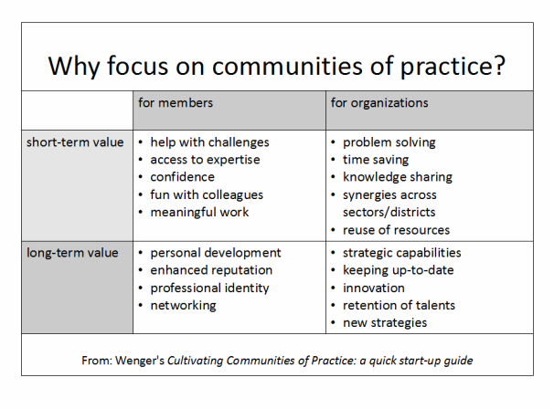
Summary

Slide 12
Questions?

Slide 13
References
Wenger, E. (n.d.). Communities of practice: A brief introduction. https://wenger-trayner.com/wp-content/uploads/2013/10/06-Brief-introduction-to-communities-of-practice.pdf
Wenger, E. (1998). Communities of Practice: Learning, Meaning, and Identity. Cambridge, MA: Harvard University Press.

